Slide 1
The 2024 Outlook
For Financial Adviser Use.
©2023 Morningstar

Slide 2
Key Topics Addressed in the 2024 Outlook
Economic Questions & Portfolio Positioning
The Big Risks Ahead, Including Geopolitics
The Growth Opportunities in AI
Taking Advantage of Higher Rates
Our Best Investment Ideas for 2024
Notes:
Our starting point for this new charts series is you.
Our job is to understand your primary concerns, then put our expertise to work to help you address them.
Here is the current state of key topics, as we understand it. If you see it differently, get in touch at simple@morningstar.com and let us address it for you.

Slide 3
Our 2024 Outlook is Differentiated
Our Starting Point is Your Clients’ Concerns. We Then Seek Morningstar’s Best Expertise to Address It

Slide 4
Top 3 Takeaways from the 2024 Outlook
The Key is a Robust Portfolio:
Some of our favoured opportunities—including banks and emerging markets—can be cyclical. We size these exposures carefully and add offsets to create more robust outcomes.​
Say Yes to Bonds: We like longer-term bonds more than we have in a decade, but we are prepared for surprises, which is why short-duration bonds still factor into our portfolio construction.​
Risk Creates Opportunity: Increasing return prospects within fixed income make it a more compelling opportunity but select equity markets still offer more attractive returns.​

Slide 5
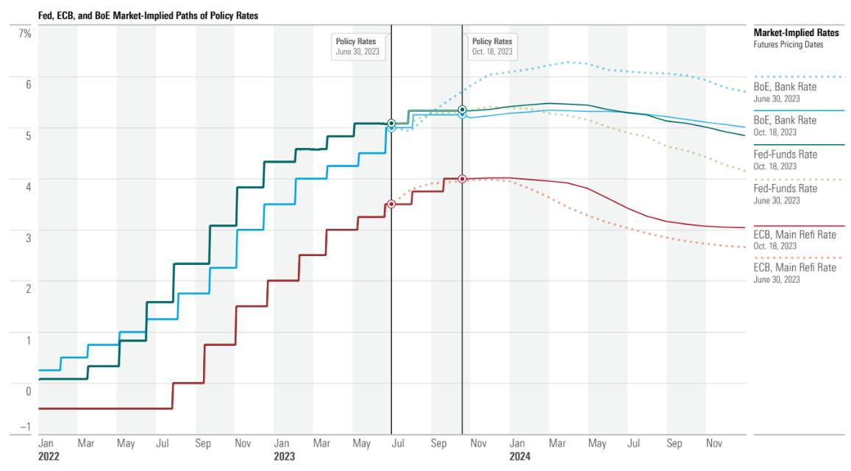
Across the U.K. and Europe, the Economic Pathway is Far From Certain
Source: OECD Data. Data as of September 30, 2023. For illustrative purposes only.

Slide 6
Eurozone Consumer Confidence Remains Weak
Europe remains fragile economically. Economic growth has been essentially flat since Covid, with the Eurozone now likely to be in a technical recession.
Source: Eurostat. Data as of September 30, 2023. For illustrative purposes only.

Slide 7
China’s Growth Trajectory is a Challenge
Many eyes are directed at China, where inflation is less of an issue. Economic weakness could still presents a challenge in 2024 though, as well as geopolitical threats over Taiwan and commercial property risks.
Source: OECD Data. Data as of September 30, 2023. For illustrative purposes only.

Slide 8
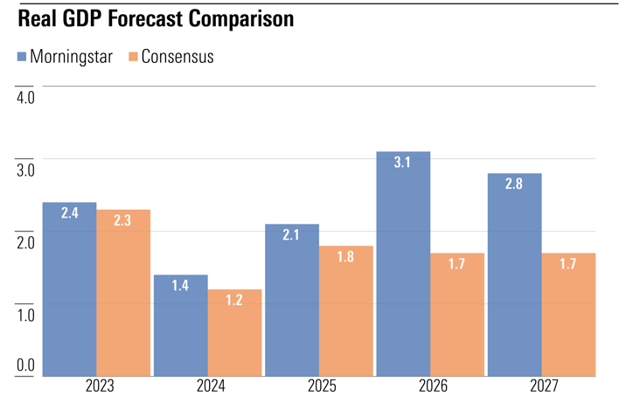
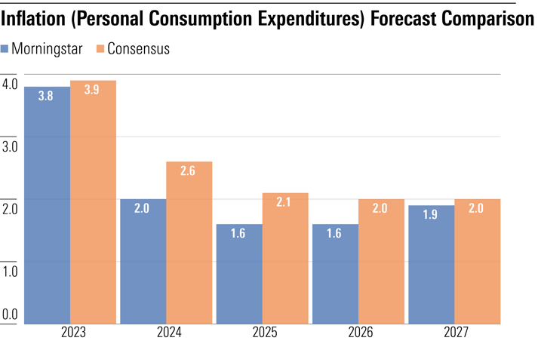
Economic Growth and Inflation in U.S. Expected to be Lower in 2024
Source: Morningstar U.S. Economic Outlook, data as of 31 October 2023. The forecasts shown are not a reliable indicator of future performance. Data presented is indicative and for illustrative purposes.

Slide 9
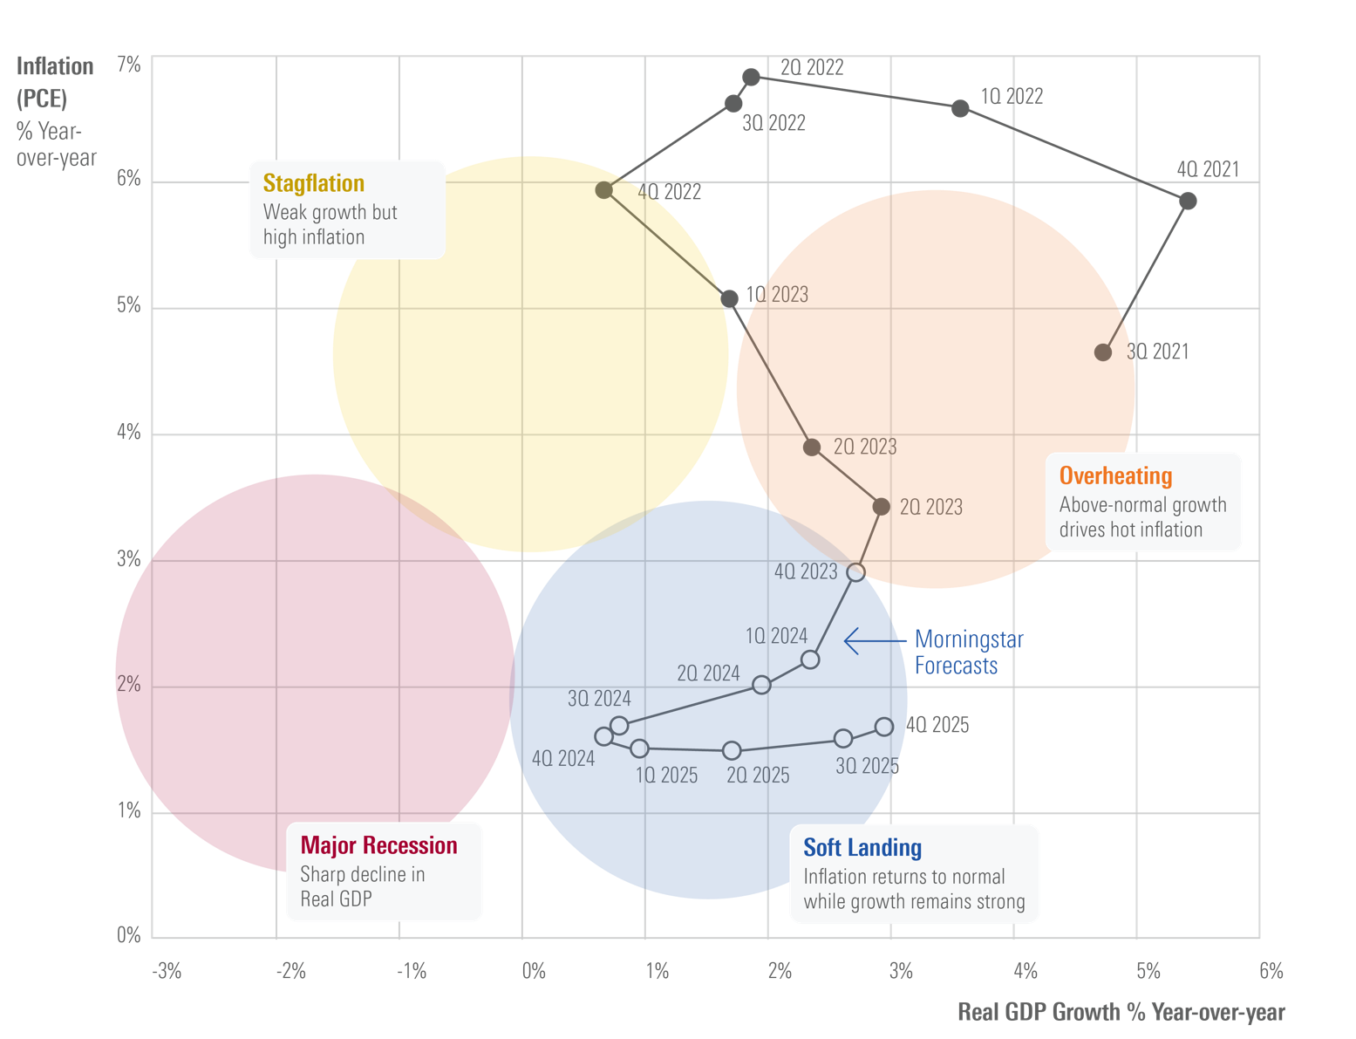
Economic Pathways Carry a Wide Range of Potential Outcomes
In terms of portfolio positioning, our base case macro-outlook of lower growth, inflation and rates, but without a recession, is supportive of classic multi asset portfolios invested in bonds and equities.
Source: Morningstar calculation. Morningstar Markets Observer. Data as of 31 October 2023. For illustrative purposes only.

Slide 10
Globally, Valuations for Defensive Sectors Look Reasonable To Us
While we see valuation dispersion between cyclical and defensive stocks, in aggregate both markets are offering discounts, while sensitive stocks are closest to fairly value.
Source: Morningstar Equity Manager Research. Sector roll up includes: Cyclical (materials, consumer cyclicals, financial services, real estate), Defensives (Healthcare, utilities, consumer staples) and Sensitives (Communication services, energy, industrials, technology). Numbers reflect the average discount across the U.S., Europe, and Asia. Data as of November 15, 2023. For illustrative purposes only.

Slide 11
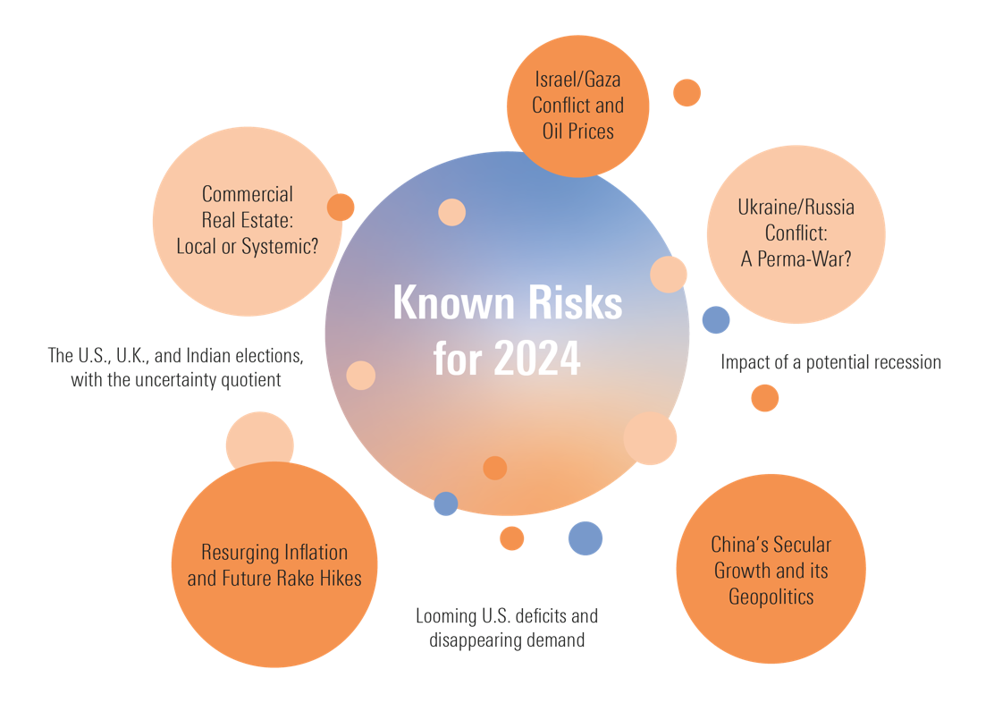
Current Headline Risks are Plentiful Entering 2024
This collection of concerns is daunting, but it’s worth remembering that not every risk requires a whole new portfolio to survive its realisation.
A well calibrated portfolio should weather external shocks fairly well.
Source: Morningstar Equity Manager Research. Sector roll up includes: Cyclical (materials, consumer cyclicals, financial services, real estate), Defensives (Healthcare, utilities, consumer staples) and Sensitives (Communication services, energy, industrials, technology). Numbers reflect the average discount across the U.S., Europe, and Asia. Data as of November 15, 2023. For illustrative purposes only.

Slide 12
Our Approach to Handling New Risks as We Enter 2024
Risk | Impact | Nature of Risk | Potential Opportunity | Offsetting Positions
Commercial Real Estate Crash | Regional bank write-downs | Cash Flow Impairment: Banks | Oversold regional banks
Expanding Middle Eastern Conflict | Energy market disruption | Oil price shocks, which, in turn, could increase recession risk for vulnerable economies |  | Cheaply priced energy assets like U.S. MLPs and European energy
Prolonged Ukraine/Russia Conflict | Energy/food market disruption, European economic pressure | Food or oil price shocks, which, in turn, could increase recession risk for vulnerable economies |  | Cheaply priced energy assets like U.S. MLPs and European energy
China’s Secular Growth Crash | Stagnating or collapsing Chinese economy | Cash Flow Impairment: Chinese Equities, Heightened recession risk for trade partners | Oversold Chinese Technology Equities
China/U.S. Conflict | Rapid reshoring, global economic uncertainty | Global equity volatility |  | Long-term, high-quality government bonds
Resurging Inflation | Higher interest rates, falling corporate earnings, heightened recession risk | Equity and fixed income volatility |  | Short-term, high-quality government bonds & hedged alternatives
Developed Market Sovereign Deficits | Increased term premium (investors demanding higher long-term yields) | Cash flow impairment: Longer-term yields reset higher, price loss |  | Short-term, high-quality government bonds & hedged alternatives
U.S. Contested Election | U.S. political uncertainty | Short-term U.S. equity volatility |  | Long-term, high-quality government bonds
Source: Morningstar. Risks assessed as of November 15, 2023. For illustrative purposes only.

Slide 13
2023 Bank’s Market Loss versus Estimated Commercial Real Estate Impairment
Source: Morningstar calculation, assessing implied impairment from commercial real estate (CRE) versus aggregate market capitalization. Banks were chosen based on the KBWB index and MER Coverage. East West Bancorp, First Horizon Corp and Western Alliance Bancorp are not covered by MER and were excluded from the analysis. Data as of November 14, 2023. For illustrative purposes only.

Slide 14
Cumulative Flows into AI & Big Data
Thematic Funds Globally Over Last Five Years
Cumulative Asset Flow in Billions (USD)
Source: Morningstar Direct, Morningstar Global Thematic Database. Data as of September 30, 2023. For illustrative purposes only.

Slide 15
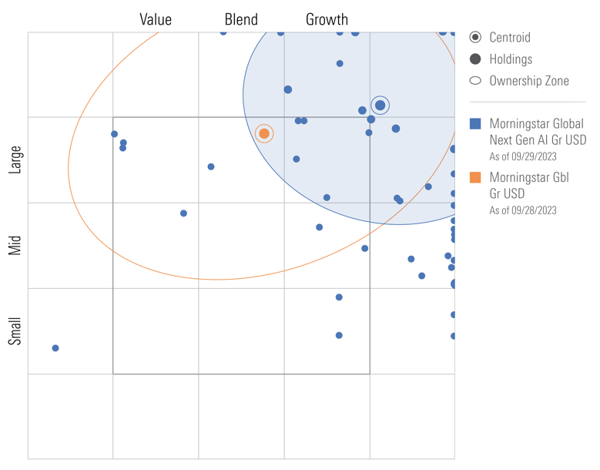
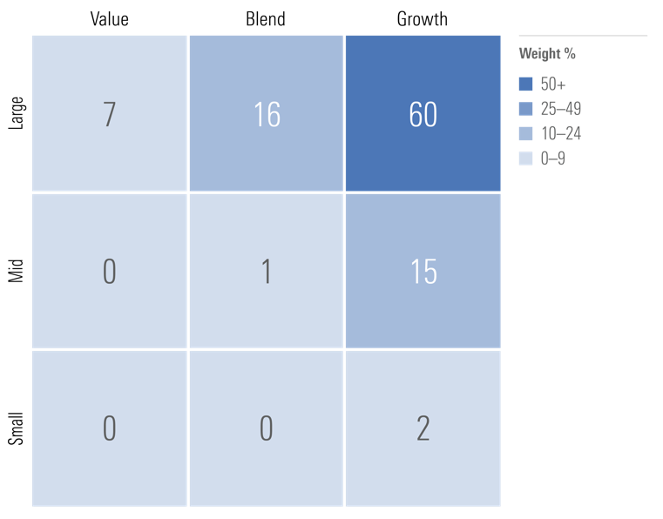
For AI, Balance Risk and Opportunity
At a Portfolio Level, Beware of Significant Style Biases
Source: Morningstar Direct. Morningstar Global Next Generation Artificial Intelligence Index. Data as of October 31, 2023. For illustrative purposes only.

Slide 16
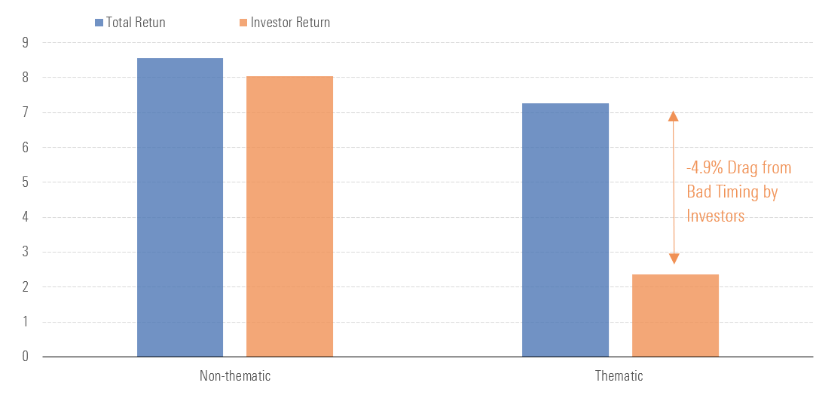
Investors Have a Bad Track Record of Timing the Entry and Exit of Thematic Funds
Source: Morningstar Direct. Morningstar Global Next Generation Artificial Intelligence Index. Data as of October 31, 2023. For Source: Morningstar Direct, Morningstar Global Thematic Research Database. 5-Year Total Returns, Investor Returns and Return Gap for Thematic and Non-Thematic Funds. Investor return is the asset-weighted return, adjusted for inflows/outflows. It shows the net impact of buying high and selling low. Data as of June 30, 2023. Domiciles included in this chart: Ireland, Luxembourg, United Kingdom, and the United States. purposes only.

Slide 17
Bond Yields are Very Attractive Relative to Recent History
Source: Morningstar Capital Markets Database. Data as of 31 October 2023. For illustrative purposes only. Past performance does not guarantee future results.

Slide 18
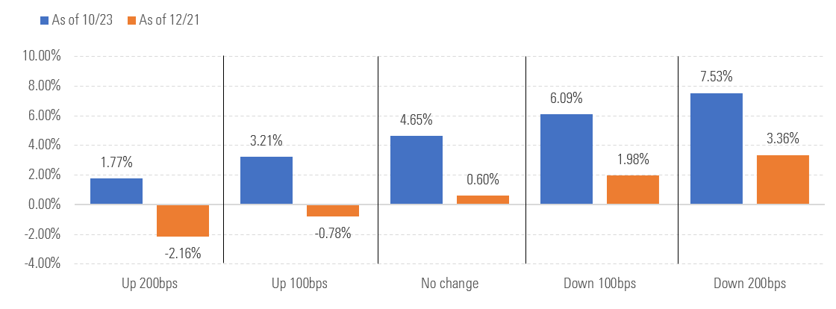
U.K. Gilt 1-Year Simulated Total Return across Interest Rate Scenarios
Source: Morningstar calculation. U.K. Gilt Yields. Data as of 31 October 2023. For illustrative purposes only. Simulated performance is not a reliable indicator of future performance.

Slide 19
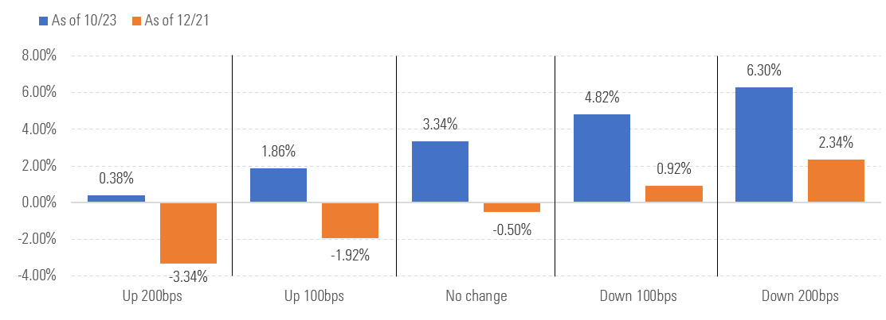
European 1-Year Simulated Total Return across Interest Rate Scenarios
Source: Morningstar calculation. European Treasury Yields. Data as of 31 October 2023. For illustrative purposes only. Simulated performance is not a reliable indicator of future performance.

Slide 20
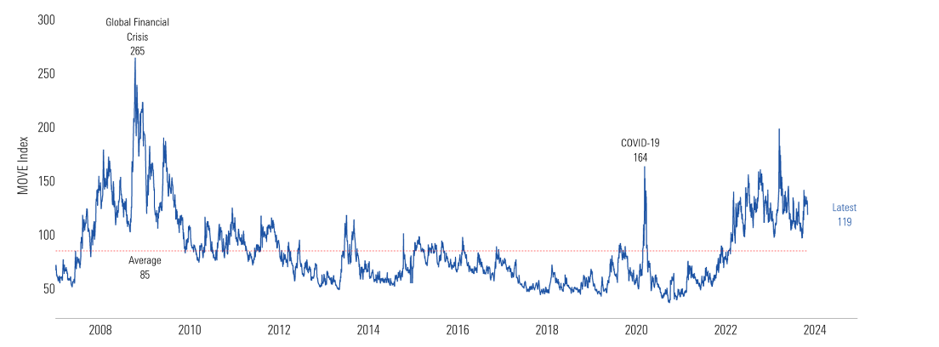
Bond Market Volatility Remains Elevated, Making Some Investors Feel Uneasy
Source: Morningstar, Clearnomics. ICE BofAML MOVE Index since 2007. Data as of November 3, 2023. For illustrative purposes only.

Slide 21
European Market Sector Indexes, Price to Fair-Value
Cyclical Sectors | Average Price/Fair Value | Sensitive Sectors | Average Price/Fair Value | Defensive Sectors | Average Price/Fair Value
t Consumer Cyclical | 0.73 | i Comm. Services | 0.84 | s Consumer Defensive | 0.86
y Financial Services | 0.84 | o Energy | 1.01 | d Healthcare | 0.84
 |  | p Industrials | 0.90 | f Utilities | 0.88
Source: Morningstar Equity Research calculations, as of November 15, 2023

Slide 22
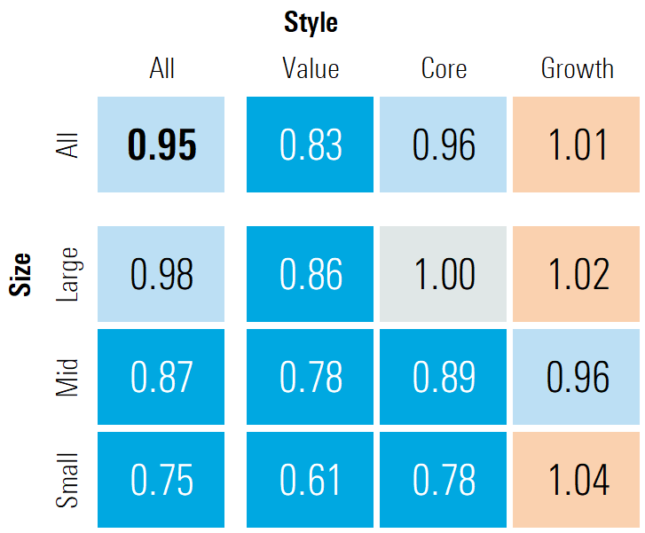
Price to Fair-Value for Morningstar U.S. Style Indexes
Looking at the style box across Europe, we can see the biggest valuation opportunity exists in the bottom left corner—small value stocks.
We note that small-cap stocks are hard to place in a single bucket, in large part because so many disparate industry groups.
Source: Morningstar Equity Research calculations, as of November 15, 2023.

Slide 23
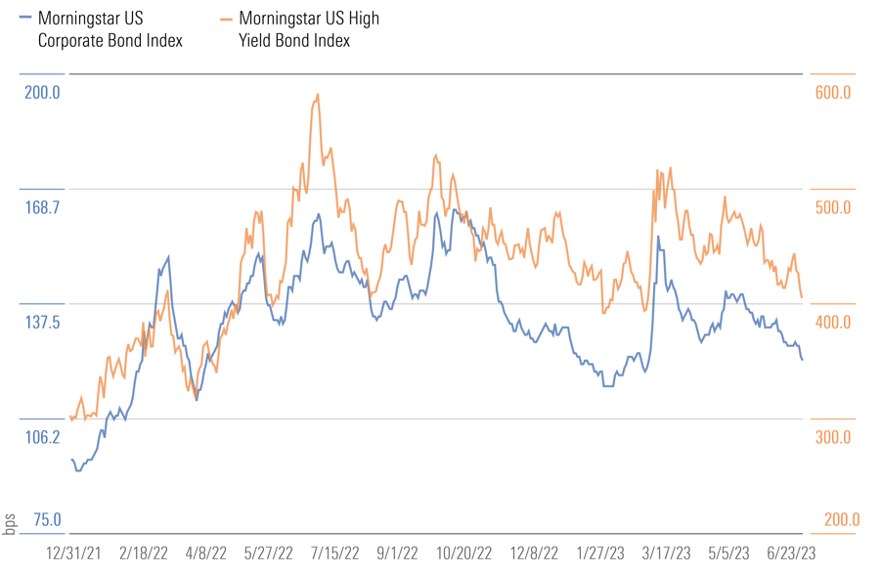
Corporate Spreads Remain Tight Despite Economic Risk
In this environment, we don’t need to stretch for yield.
For this reason, our analysis leads us to favor government bonds—particularly U.S. Treasuries—on a risk-adjusted basis. Withstanding another serious inflation run, the skew of upside to downside looks favorable to us. Of note, we do see appeal in short-term corporate bonds, where we can achieve positive real yields.
Source: Morningstar U.S. Corporate Bond Index, Morningstar U.S. High Yield Bond Index, data as of October 31, 2023.

Slide 24
Summary of Portfolio Opportunities
Taken together, the below culminates as a list of our best ideas. By balancing these convictions into a broader diversified portfolio, we foresee a positive outlook for 2024 and beyond
Source: Morningstar U.S. Corporate Bond Index, Morningstar U.S. High Yield Bond Index, data as of October 31, 2023.

Slide 25
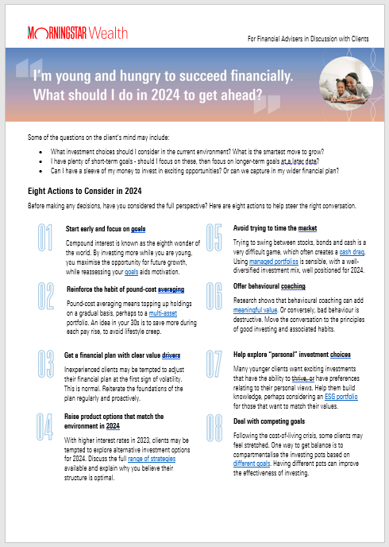
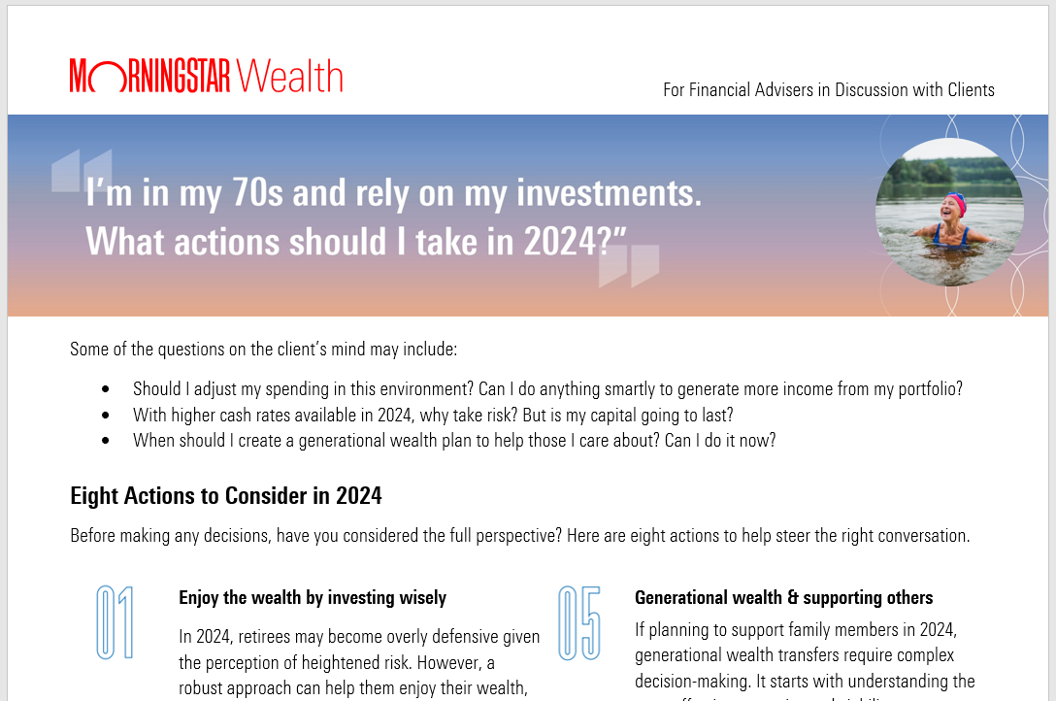
Engage With Your Clients, Whether 30, 40, 50, 60 or 70 Years Old
Source: Morningstar U.S. Corporate Bond Index, Morningstar U.S. High Yield Bond Index, data as of October 31, 2023.

Slide 26
Thank You for Your Engagement

Slide 28
Appendix

Slide 29
U.S. Government Bond Monthly Performance When Geopolitical Risk Spikes
Source: Morningstar Direct, SBBI Long Term Government Bond Index, and SBBI 1 Year Constant Treasury Index. Data from Jan 1961 through October 2023. Geopolitical events identified by the Historical Geopolitical Risk Index. Index downloaded from https://www.matteoiacoviello.com/gpr.htm on November 10, 2023. Periods of heightened geopolitical risk identified by first targeting months with an index level at one standard deviation and then selecting those months in which the subsequent month had a higher index level. For illustrative purposes only.

Slide 30
Between AI Semis and Software, A Long Growth Runway Lies Ahead
Source: Morningstar, Company Documents. Data as of Oct 3, 2023. For illustrative purposes only.

Slide 31
The Top 10 Stocks Held in Artificial Intelligence and Big Data ETFs and Mutual Funds Globally
Name | Ticker | Sector | Morningstar Star Rating | Economic Moat
NVIDIA Corp | NVDA | Technology | ««« | Wide
Microsoft Corp | MSFT | Technology | ««« | Wide
Alphabet Inc Class A | GOOGL | Communication Services | «««« | Wide
Amazon.com Inc | AMZN | Consumer Cyclical | ««« | Wide
Advanced Micro Devices Inc | AMD | Technology | ««« | Narrow
Tesla Inc | TSLA | Consumer Cyclical | ««« | Narrow
ServiceNow Inc | NOW | Technology | ««« | Wide
Meta Platforms Inc Class A | META | Communication Services | ««« | Wide
Taiwan Semiconductor Manufacturing Co Ltd ADR | TSM | Technology | ««««« | Wide
Snowflake Inc Ordinary Shares - Class A | SNOW | Technology | «««« | None
Source: Morningstar Global Thematic Database, Star Rating and Economic Moat Data as of October 31, 2023. For illustrative purposes only. Please note that references to specific securities or other investment options within this piece should not be considered an offer (as defined by the Securities and Exchange Act) to purchase or sell that specific investment.

Slide 32
High-Yield Bond Maturity Schedule as a Percentage of Outstanding
No Signs of a Debt Cliff.
Source: Morningstar calculation. Morningstar U.S. High Yield Bond Index. Data as of 31 October 2023. Forecasts are not a reliable indicator of future performances and are for illustrative purposes only.

Slide 33
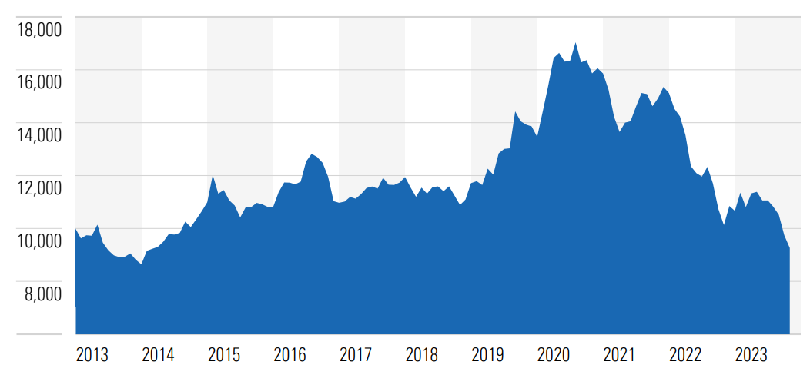
The 10-Year + U.S. Treasury Index has Fallen Heavily. Bonds are Now Appealing
-41.7%
Source: Morningstar Direct, Morningstar US 10+ Yr Treasury Bond TR USD, data as of November 15, 2023. For illustrative purposes only.

Slide 34
The Yield Curve (10-Year Minus 2-Year) is Still Negative in the U.S.
Source: Federal Reserve Bank of St. Louis, 10-Year Treasury Constant Maturity Minus 2-Year Treasury Constant Maturity, as of October 31, 2023.

